Slide 1

CS677- Spring 2025 CRN#22550 Machine Learning
Bank Marketing: Predicting Term Deposit Subscriptions
Team 8 – Mohanaprasath, Sajan, Nithesh

Slide 2






STEP-1 Problem Statement & Objectives
Enhance Targeting
Identify high-probability subscribers
Improve Efficiency
Reduce resources spent on unlikely conversions
Build Predictive Model
Develop binary classification for term deposit subscriptions
This project analyzes data from direct phone-based marketing campaigns conducted by a Portuguese banking institution.
The objective is to predict whether a client will subscribe to a term deposit (y) based on various features such as demographic details, financial status, previous campaign outcomes, and especially the duration of the last call, which plays a critical role in client conversion.
By developing a binary classification model, the goal is to help the bank target the right clients, reduce unnecessary follow-ups, and maximize campaign efficiency.

Slide 3
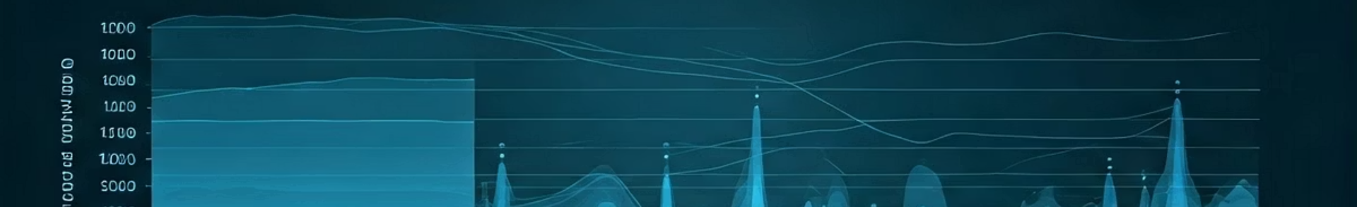
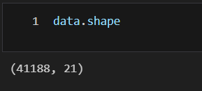
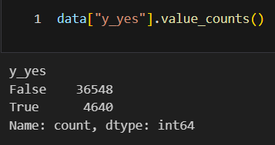
Dataset Overview
Shape of the Data
Key Features
Target Variable
Demographic: age, job, education
Campaign: contact, duration, previous outcomes
Economic: consumer price index, confidence index
Our target variable heavily imbalanced.
Around 88.7% of clients did not subscribe to a term deposit, while only 11.3% did.
This imbalance can cause models to favor the majority class, leading to misleading results

Slide 4
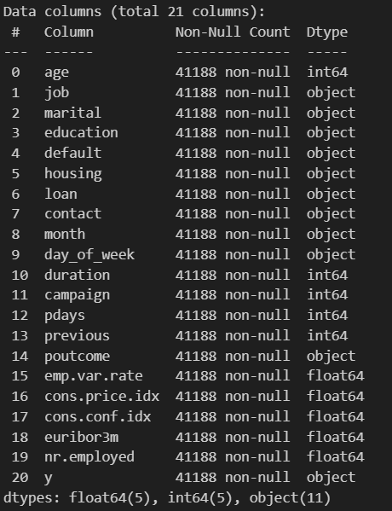

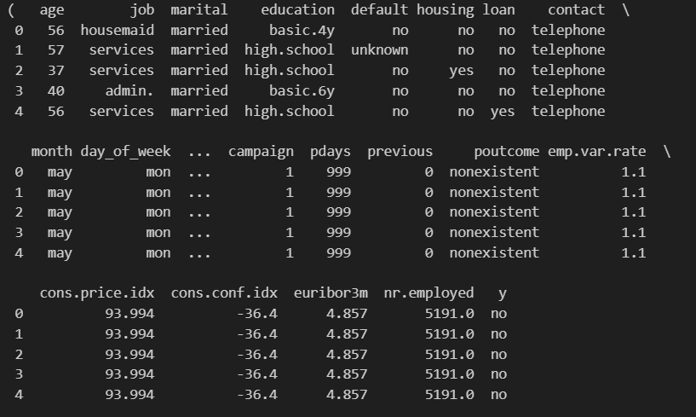
Dataset Overview

Slide 5
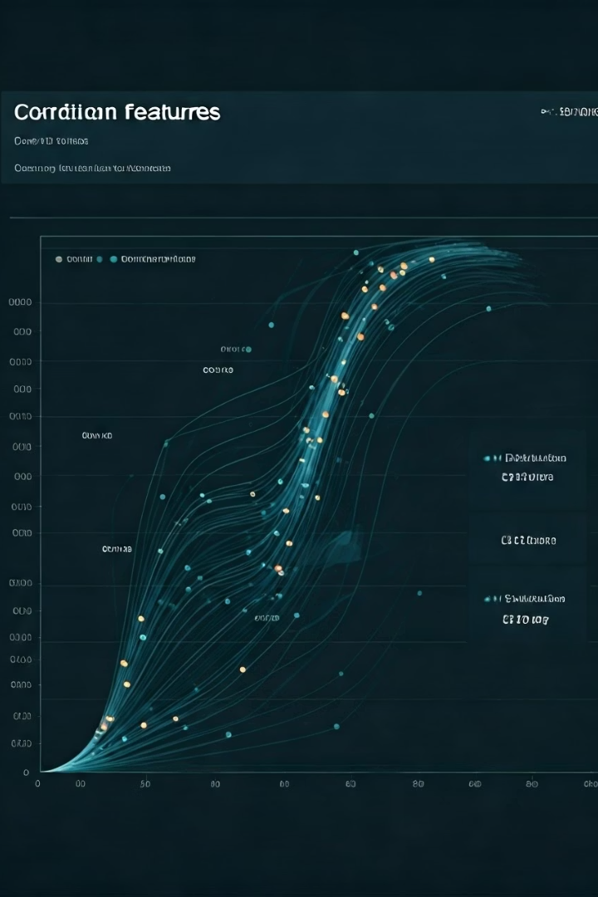




STEP-2 Exploratory Data Analysis
Missing Values Detection
Identified missing values and handling them
Distribution Analysis
Generated heatmaps to identify relationships between features
Pattern Identification
Discovered key trends in customer behavior across segments
Anomaly Detection
Identified outliers and data quality issues requiring preprocessing
Our exploratory analysis revealed several critical insights. Age distribution showed distinct response patterns across different life stages. Professional categories demonstrated varying subscription propensities, with certain occupations showing significantly higher conversion rates. Previous campaign outcomes strongly correlated with future subscription behavior.
The correlation analysis highlighted multicollinearity between certain economic indicators, suggesting feature selection opportunities. Additionally, we observed a notable class imbalance in the target variable, with only about 11% positive subscription outcomes.

Slide 6
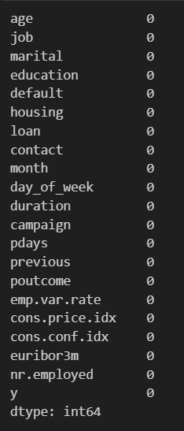

Finding Missing Values
We checked for missing values in all columns
No missing values were found in any of the features.
This means we did not need any imputation or data cleaning for null entries.
The dataset is complete and ready for preprocessing and modeling.

Slide 7
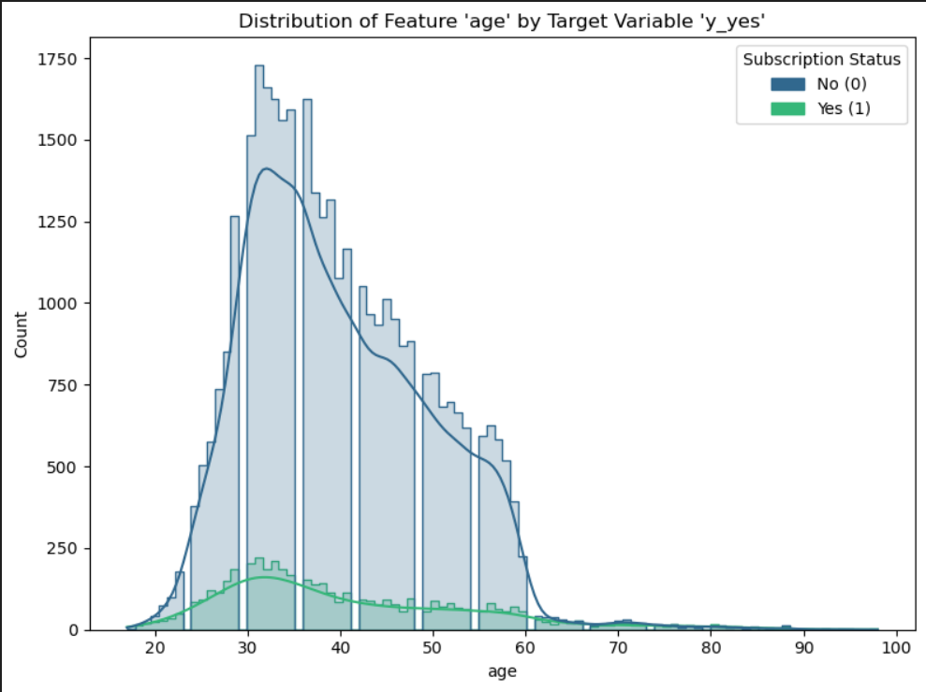
Distribution Analysis
Age vs Subscription Trend
The plot shows how age influences the likelihood of subscribing to a term deposit
Most clients are between 25 and 60 years old, with a peak around ages 30 to 35
Subscriptions are more common among clients aged 30 to 50, especially in the 30 to 40 range
Fewer subscriptions are seen among younger clients under 25 and older clients above 60
This suggests that middle-aged clients are more responsive to marketing campaigns compared to very young or older clients

Slide 8
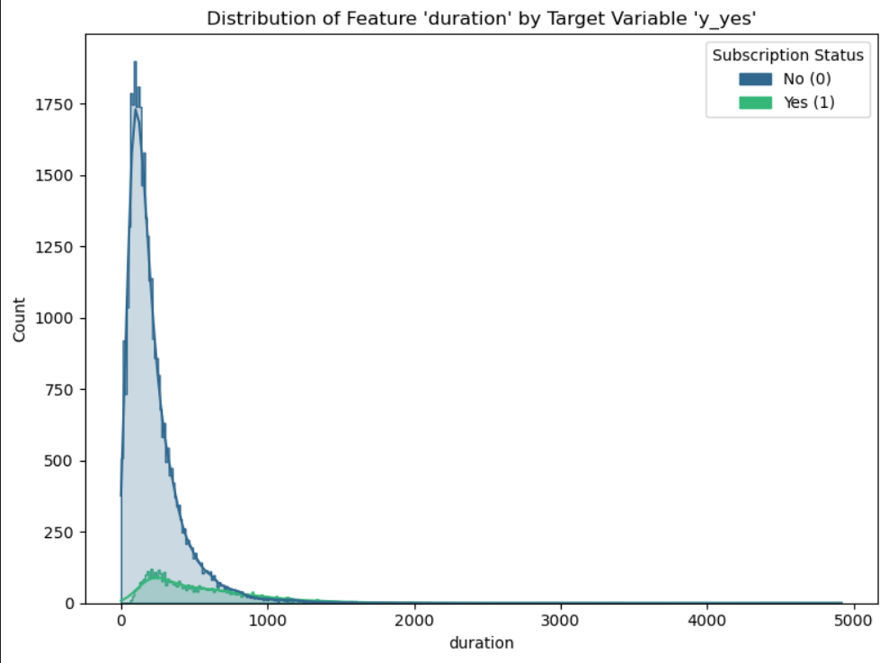
Distribution Analysis
Duration vs Subscription Trend
This plot shows how the duration of the last call is related to client subscription
Most calls are short, with the majority lasting under 500 seconds
Clients who subscribed generally had longer call durations compared to those who did not
The number of subscriptions increases with call duration up to a certain point
This indicates that longer conversations tend to lead to higher chances of subscription

Slide 9
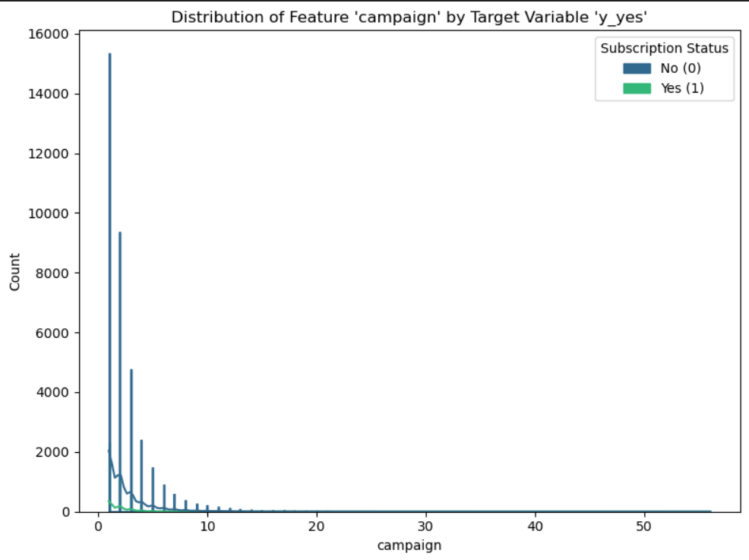
Distribution Analysis
Campaign vs Subscription Trend
This plot shows how many times a client was contacted during the campaign period
Most clients were contacted fewer than 5 times, with a sharp drop after that
A high number of contacts does not significantly increase the chance of subscription
In fact, subscription rates seem to be higher when the number of contacts is low
This suggests that repeated calls may reduce interest or lead to customer fatigue

Slide 10
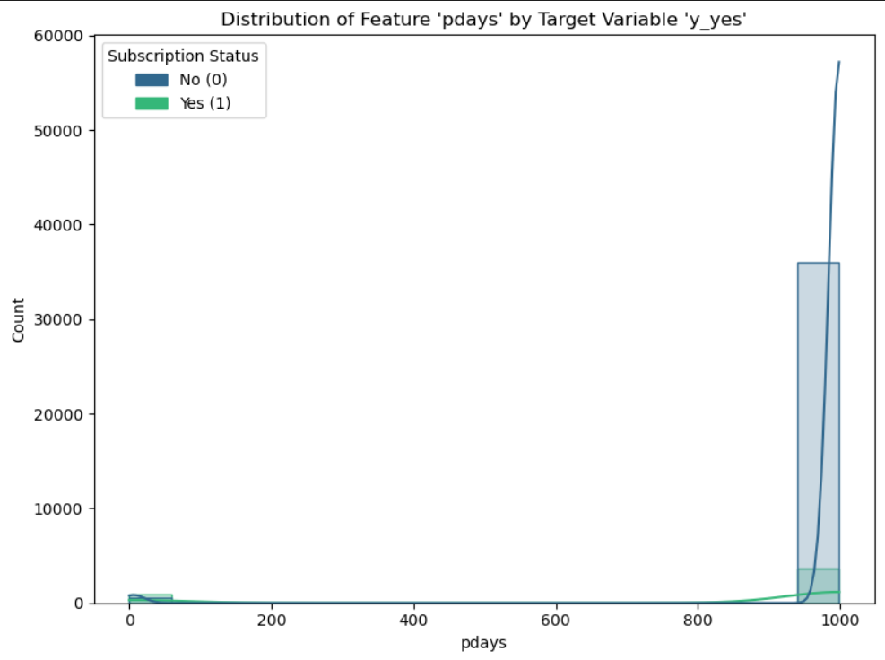
Distribution Analysis
Pdays vs Subscription Trend
The pdays feature represents the number of days since the client was last contacted in a previous campaign
A value of 999 means the client was never previously contacted
Most clients in the dataset have a value of 999, indicating no prior contact
Among those who were previously contacted (pdays less than 999), the subscription rate is relatively higher
This suggests that clients with past contact history are slightly more likely to subscribe, while a large portion of the data has no prior contact

Slide 11
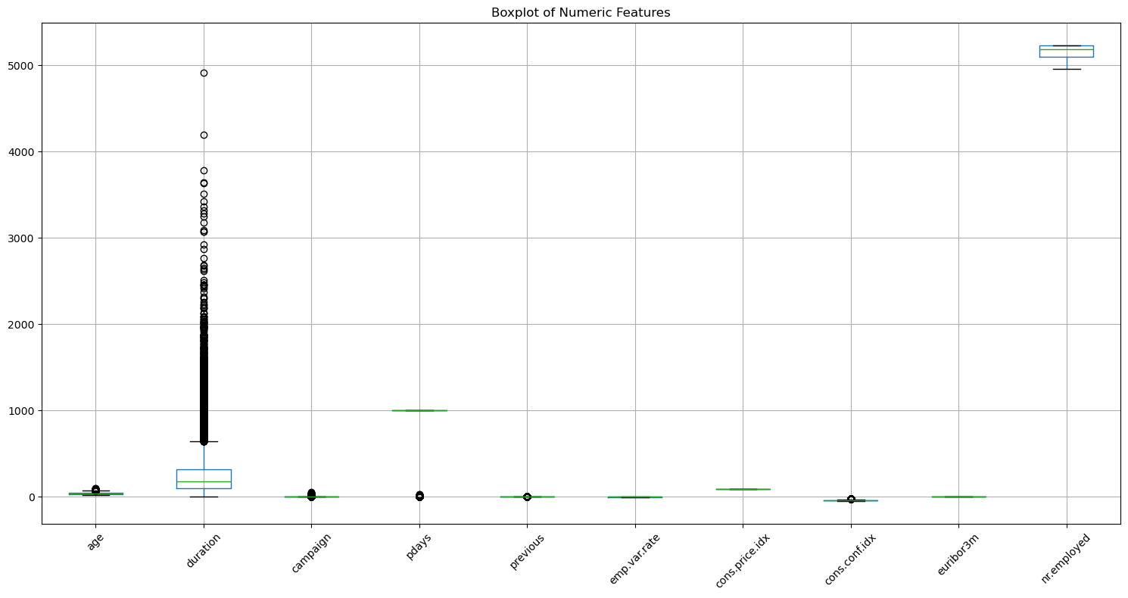
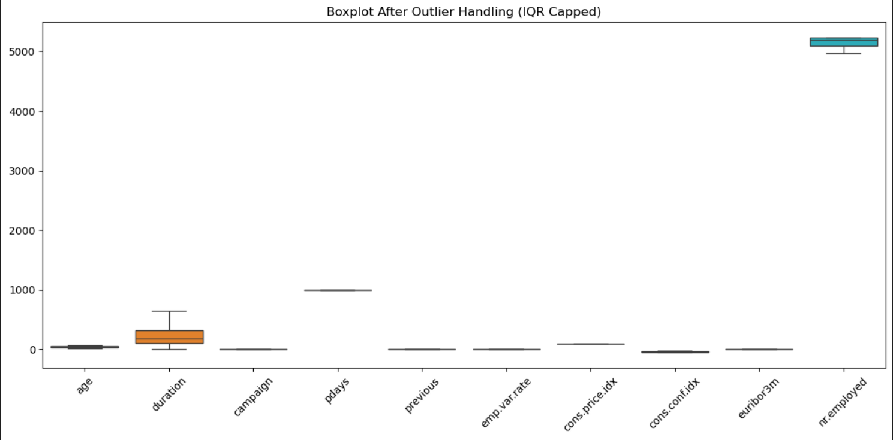
Outliers Detection
Outliers Handling Using IQR Cap

Slide 12
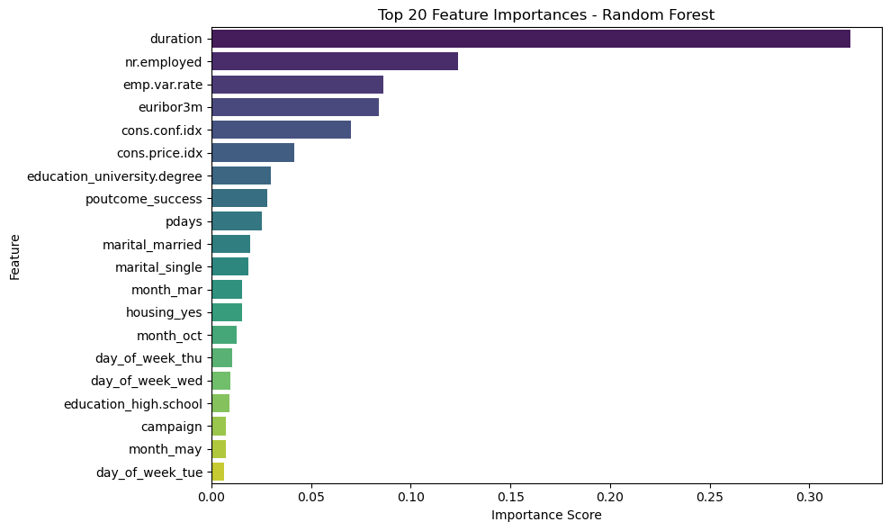
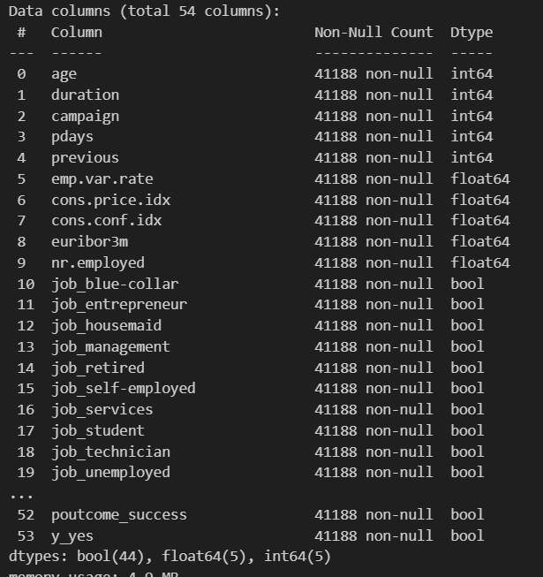
Feature Importances
One-Hot Encoding

Slide 13
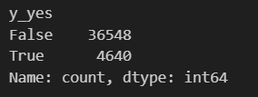
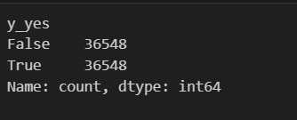
SMOTE (Synthetic Minority Oversampling Technique)
Before Sampling
After Sampling
Balancing the Dataset with SMOTE
Before sampling, the target variable y_yes was highly imbalanced
Only 4,640 positive samples compared to 36,548 negatives
We used SMOTE (Synthetic Minority Oversampling Technique) to generate new synthetic samples for the minority class
After sampling, both classes were perfectly balanced at 36,548 each
This ensures the model receives equal exposure to both outcomes, improving fairness and predictive accuracy for the minority class

Slide 14



STEP-3 Model Training and Data Splitting
Decision Trees
Random Forest
Interpretable baseline with visualization capabilities
Ensemble method with improved generalization
Naive Bayes
XGBoost
🧠
⚡
Fast and efficient for text and categorical data
Boosted tree model optimized for performance and speed; handles complex patterns
K-Nearest Neighbors
Logistic Regression
👥
Classifies based on similarity to nearby data points
Simple and interpretable model for binary classification problems
The dataset was split into training (80%) and testing (20%) sets using a stratified approach
Stratified splitting ensures that the class distribution remains balanced across both sets
Feature scaling was applied using StandardScaler to normalize all numeric features
The resulting shapes are:
X_train: 51,167 samples, 13 features
X_test: 21,929 samples, 13 features
The following six machine learning models were trained and evaluated:

Slide 15
Stratified K-Fold Cross-Validation
Stratified K-Fold Cross-Validation
Random Forest achieved the highest mean accuracy of 95.22%, with a low standard deviation (0.0025), indicating both high performance and stability
XGBoost followed closely with a mean accuracy of 94.94%, also showing consistent results
Logistic Regression, K-Nearest Neighbors, and Decision Tree performed well, with mean accuracy between 91% and 93%
Naive Bayes had the lowest accuracy (81.03%) due to its simplistic assumptions
Lower standard deviation values across all models suggest that the performance is consistent across different data splits
Model
Mean Accuracy
Standard Deviation
Logistic Regression
0.9315
0.0044
Naive Bayes
0.8103
0.0046
K-Nearest Neighbors
0.9132
0.0046
Decision Tree
0.9283
0.0038
Random Forest
0.9522
0.0025
XGBoost Boosting
0.9494
0.0022

Slide 16
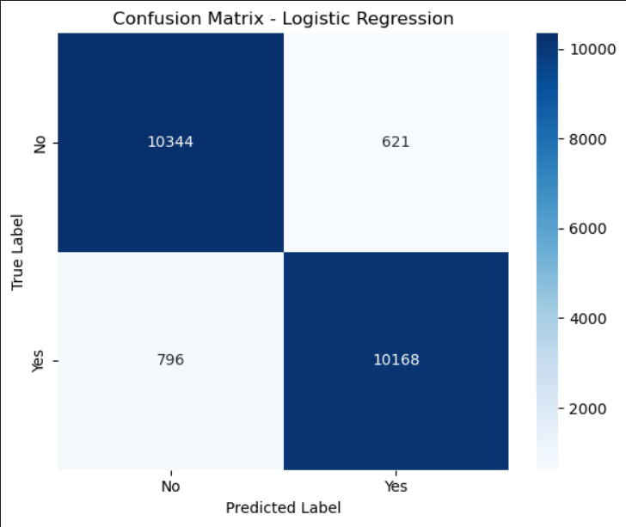
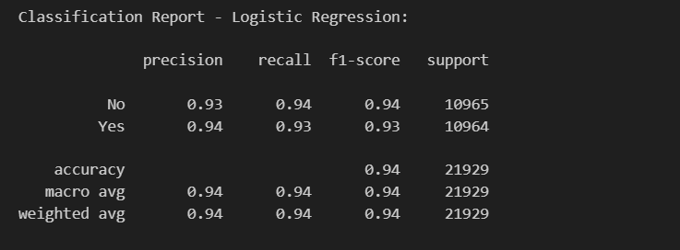
STEP-4 Model Evaluation Confusion matrix
Logistic Regression
Logistic Regression achieved a strong overall accuracy of 94%, indicating it learned the relationship between features and the target variable very well
From the confusion matrix, we see that the model correctly predicted over 10,000 instances for both classes — 'Yes' and 'No’
The model’s high precision for ‘Yes’ (0.94) means that when it predicts a client will subscribe, it’s right most of the time.
The recall for ‘Yes’ is slightly lower (0.93), suggesting a few potential subscribers are missed — likely those who share overlapping traits with non-subscribers
This balance between precision and recall results in a solid F1 Score of 0.93, making the model reliable and consistent

Slide 17
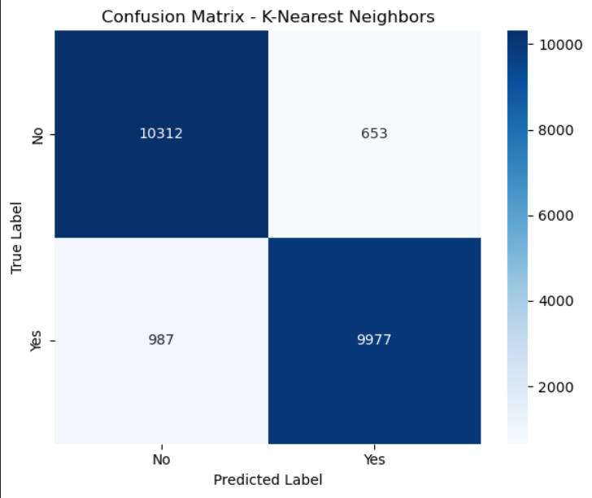
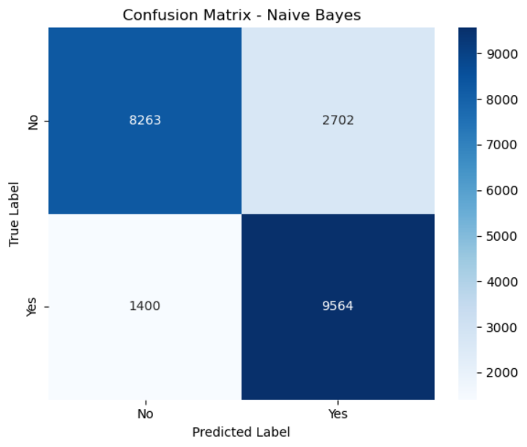
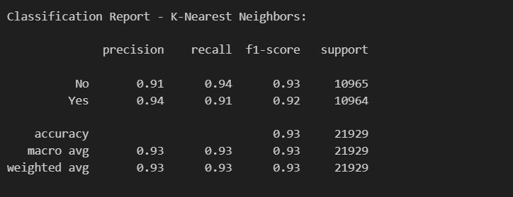
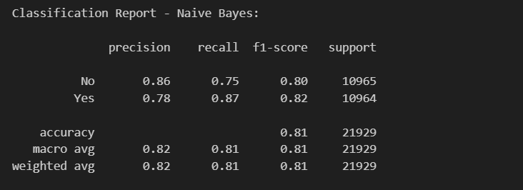
K-Nearest Neighbors
Naive Bayes

Slide 18
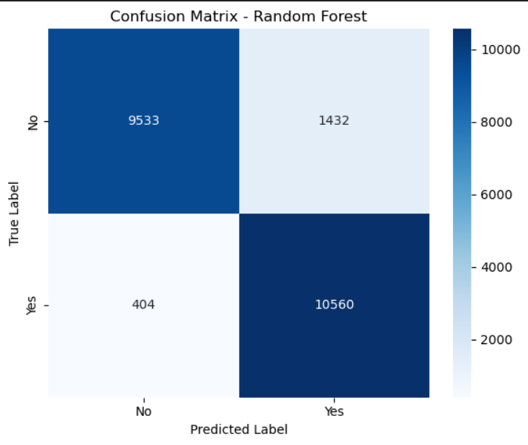
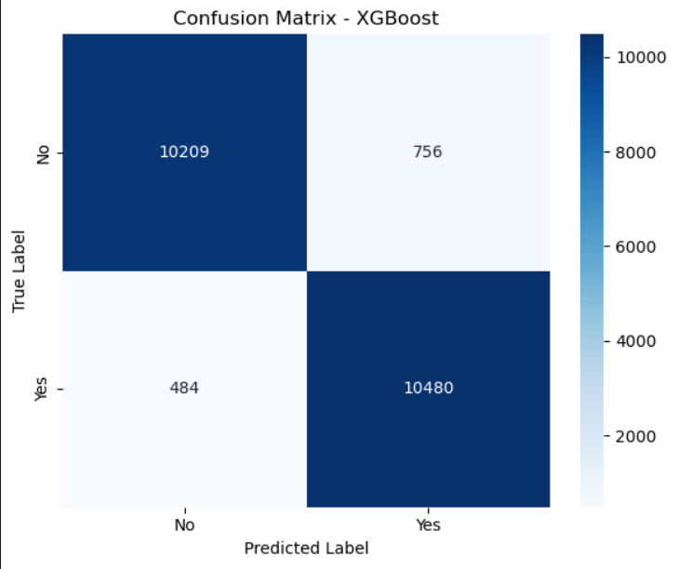
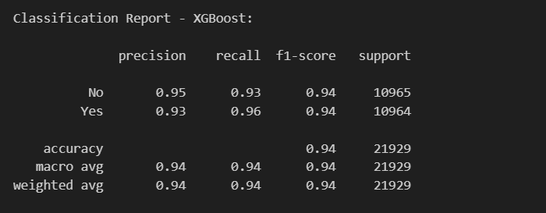
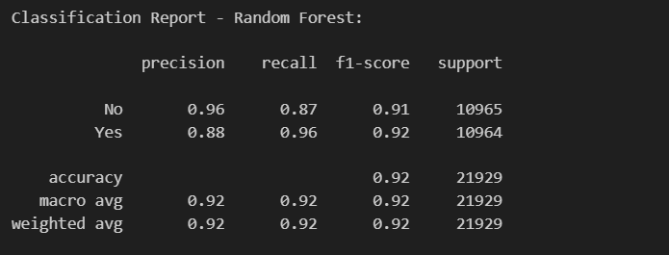
Random Forest
XGBoost

Slide 19
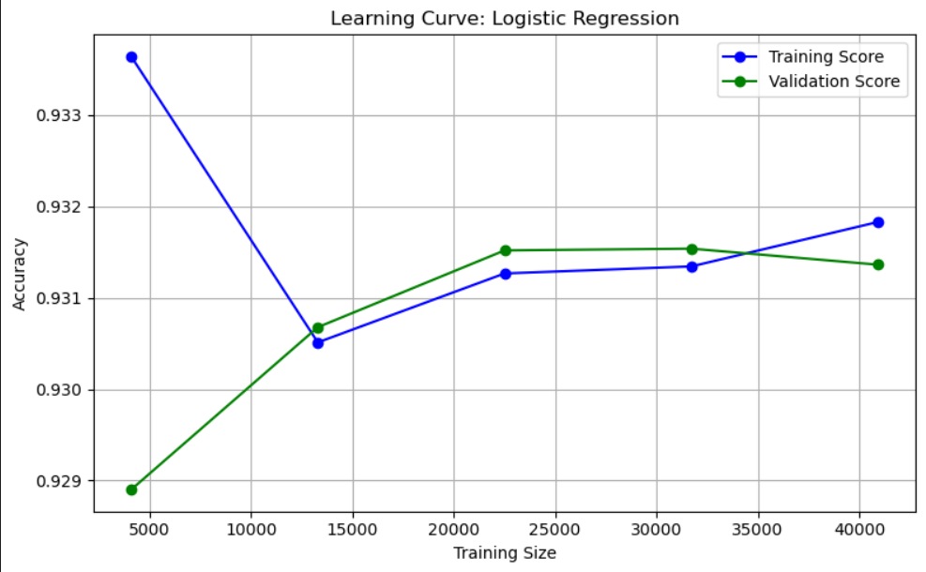
Learning Curve
Learning Curve – Logistic Regression
This graph shows how the model performs as we give it more training data
Initially, the training score is higher than the validation score, indicating some overfitting when data is limited
As we increase the training size, both the training and validation scores start to come together
Eventually, the two lines flatten and stay close to each other — this means the model is learning well and not overfitting or underfitting
After around 30,000 samples, adding more data doesn’t make much of a difference, which suggests the model has learned all it can from the patterns

Slide 20
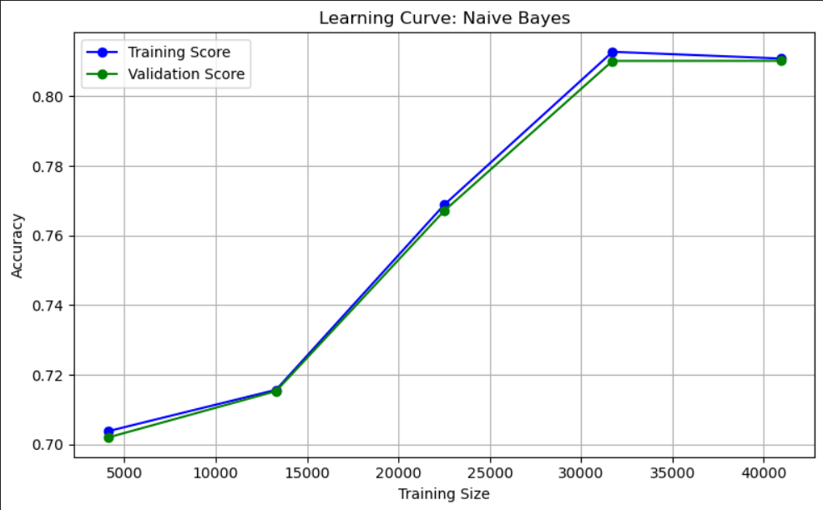
Learning Curve
Learning Curve – Naive Bayes
Both the training and validation scores start off low (around 70%) but gradually improve as more data is used
What’s interesting is how closely the two lines track each other — this means the model is consistent and not overfitting
Around 30,000 samples, the model reaches its peak performance (just above 80%) and then flattens out
This suggests Naive Bayes benefits from more data, but its performance is limited by its simple assumptions
Overall, the model learns steadily but tops out earlier than more complex models like Random Forest or XGBoost

Slide 21
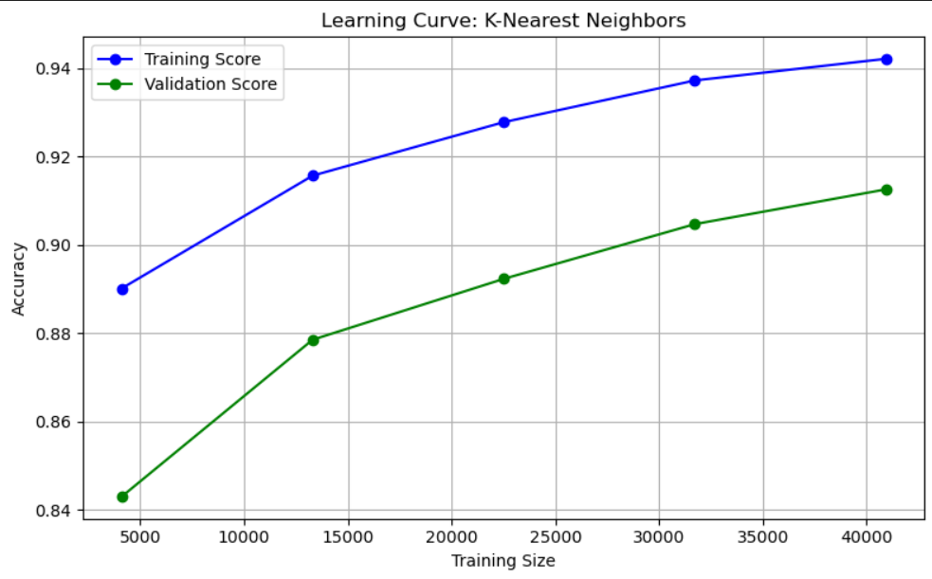
Learning Curve
Learning Curve – K-Nearest Neighbors
The training score starts off high and keeps improving steadily — which is expected, because KNN tends to memorize the training data
The validation score also improves, but the gap between training and validation remains noticeable throughout
This gap suggests that the model might be slightly overfitting — it performs better on the training data than on unseen data
However, as we increase the dataset size, both scores continue to rise, and the gap slightly narrows, showing improved generalization
KNN clearly benefits from more data, but because it's a lazy learner, performance depends heavily on the dataset size and distribution

Slide 22
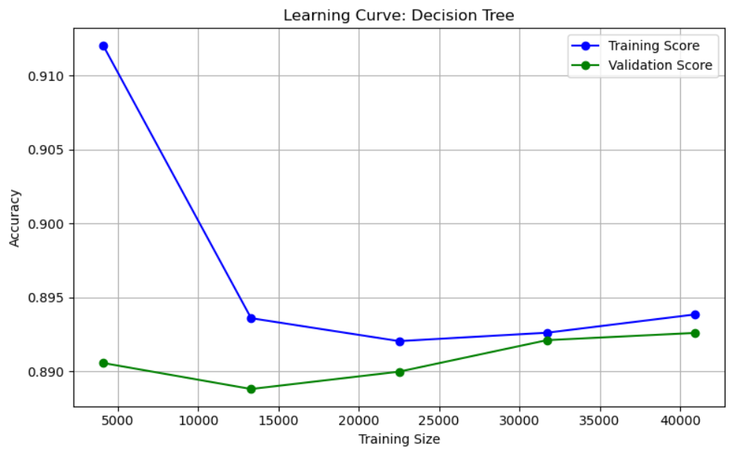
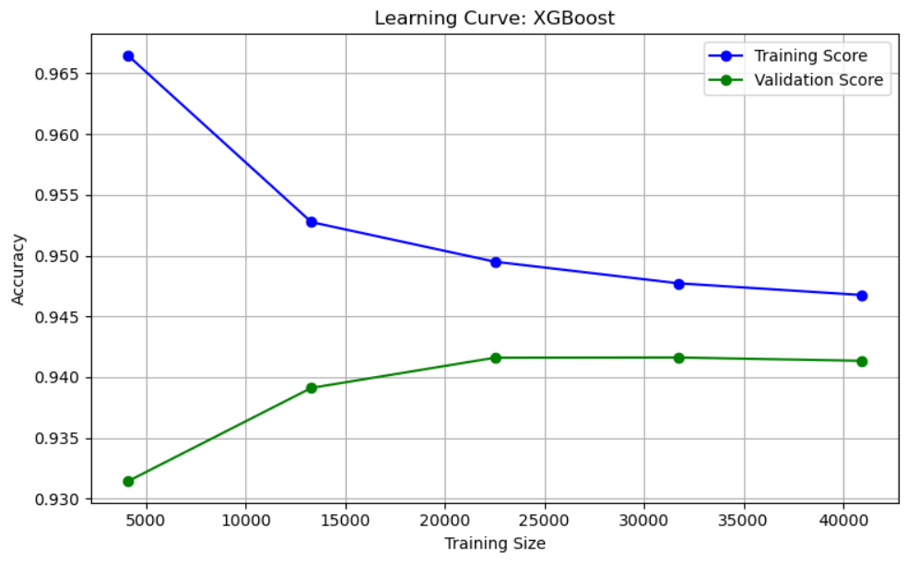
Decision Tree
XGBoost
At the beginning, the model shows very high training accuracy, but validation accuracy is noticeably lower — a sign of overfitting
As the training size increases, the training accuracy drops and the validation accuracy improves slightly, suggesting that the model is trying to generalize better
At the beginning, the model shows very high training accuracy, but validation accuracy is noticeably lower — a sign of overfitting
As the training size increases, the training accuracy drops and the validation accuracy improves slightly, suggesting that the model is trying to generalize better

Slide 23
Overfitting and Underfitting Checking
Based On Confusion Matrix
Model | True Positives | True Negatives | False Positives | False Negatives | Notes
Logistic Regression | 10,168 | 10,344 | 621 | 796 | Well generalized
Naive Bayes | 9,564 | 8,263 | 2,702 | 1,400 | Mixed; more false positives
K-NN | 9,977 | 10,312 | 653 | 987 | Well generalized
Decision Tree | 10,033 | 9,492 | 1,473 | 931 | Well generalized
Random Forest | 10,560 | 9,533 | 1,432 | 404 | Well generalized
XGBoost | 10,480 | 10,209 | 756 | 484 | Well generalized
Well generalized models have low FP and FN and similar performance across both classes
Naive Bayes has high FP and FN, showing bias and less confidence in separating classes
Random Forest and XGBoost both had high TP and low FN, making them very strong performers
Decision Tree and KNN also performed well, but slightly more false predictions compared to ensemble methods

Slide 24
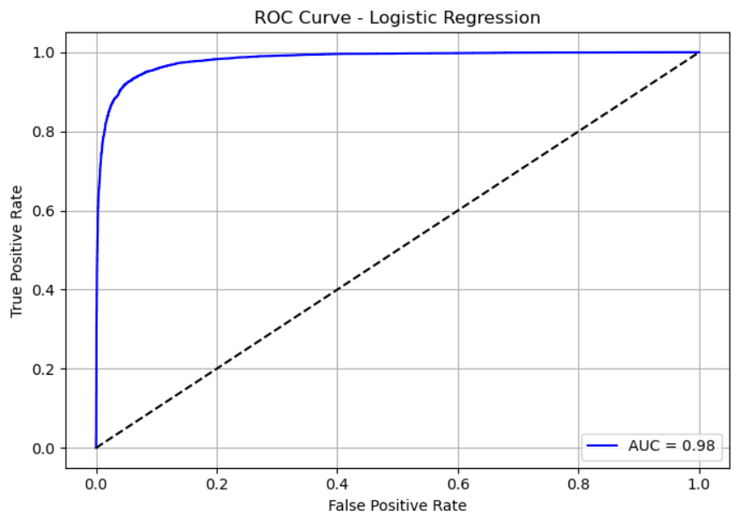
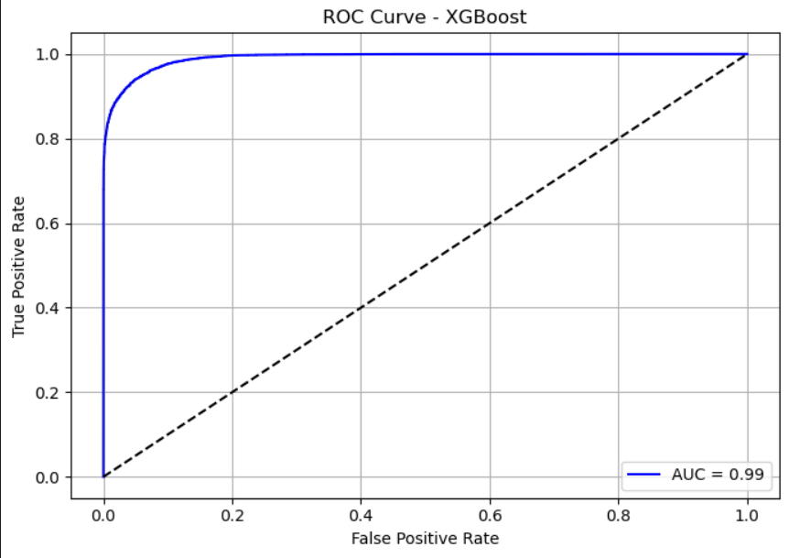
ROC and AUC Curves
XGBoost
This curve shows how well the model separates the two classes
The closer the curve is to the top-left corner, the better the performance — and this one is almost perfect
The AUC score is 0.98, meaning the model is 98% effective at distinguishing between positive and negative classes
This confirms that Logistic Regression is highly reliable for this classification task
The AUC (Area Under Curve) is 0.99, meaning the model is almost perfect at telling the difference between subscribers and non-subscribers
Compared to other models, XGBoost shows the highest discrimination power with minimal false positives
This confirms XGBoost is one of the best-performing models in our comparison

Slide 25
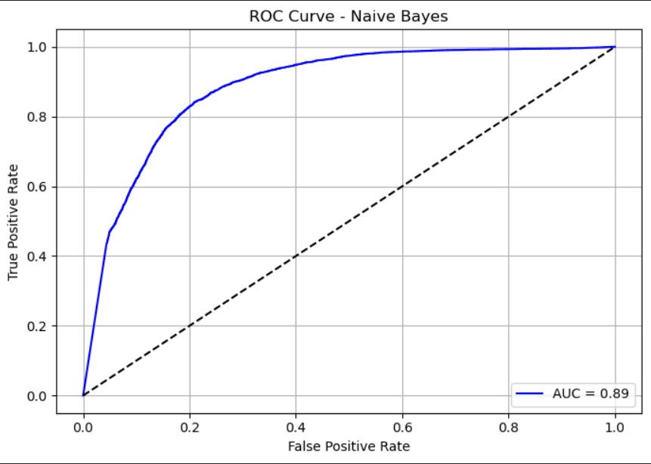
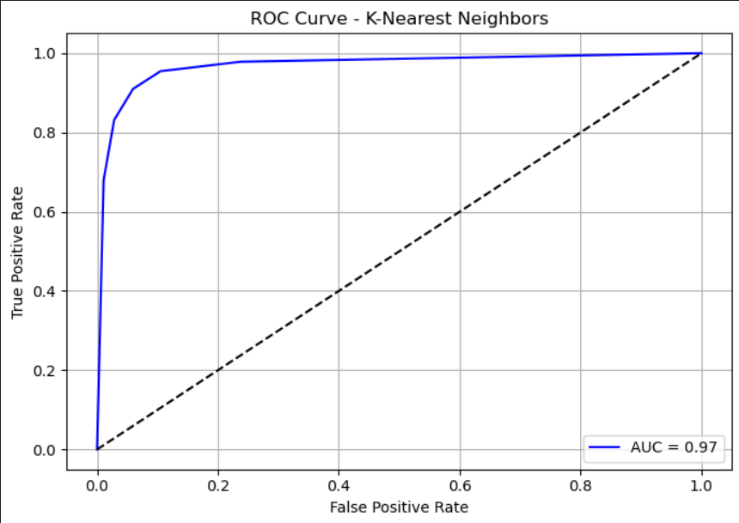
Naive Bayes
K-Nearest Neighbors
The AUC score is 0.89, which means the model does a good job at separating classes, but it's not as strong as Logistic Regression or XGBoost.
This suggests Naive Bayes struggles a bit more with class overlap or data complexity.
Overall, it performs well as a baseline, but has lower predictive power compared to other models
With an AUC score of 0.97, KNN demonstrates high sensitivity and low false positive rate.
This indicates the model is highly capable of distinguishing between clients who will subscribe and those who won’t.
Overall, KNN proves to be a reliable and effective classifier in this task

Slide 26
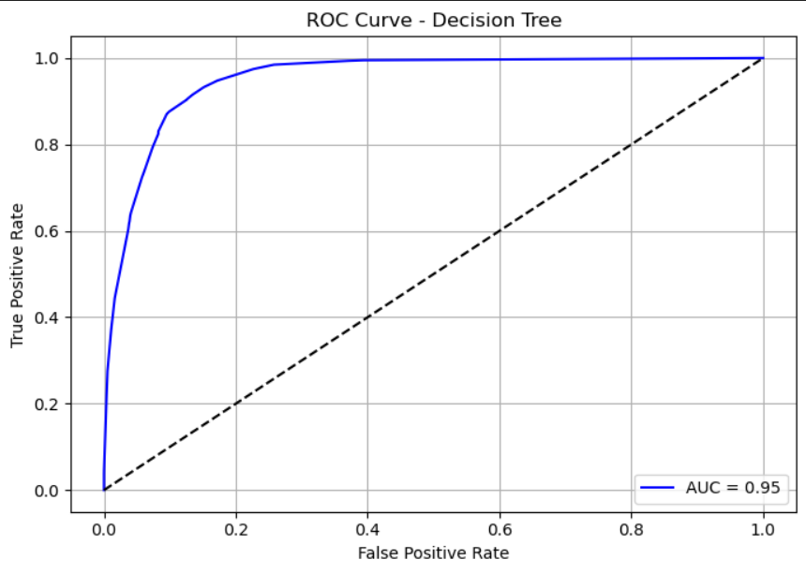
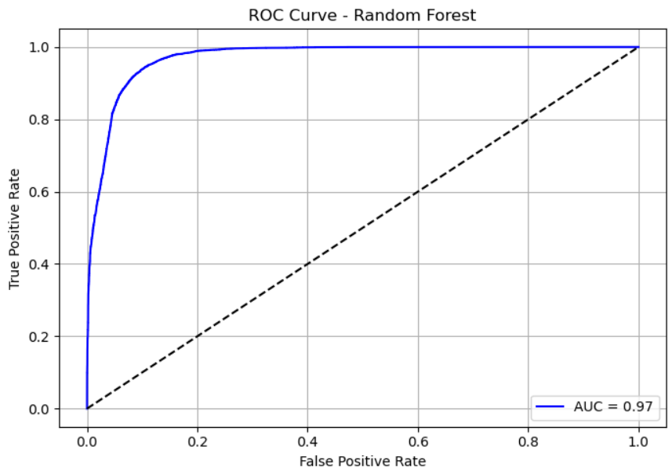
Decision Tree
Random Forest
With an AUC score of 0.95, the Decision Tree model performs strongly in distinguishing between the classes.
However, compared to models like XGBoost or Random Forest, it may be more prone to overfitting.
Overall, the model offers solid performance, especially when trained on balanced and clean data.
With an AUC score of 0.97, the model handles class separation very effectively.
It achieves a strong balance between true positive rate and false positive rate.
Overall, Random Forest proves to be a highly reliable model with consistent classification strength across all thresholds.

Slide 27
Hyperparameter Tuning Comparison
Model Tuning Summary & Insights
Logistic Regression:- We tuned the regularization strength by setting C = 0.5. This gave us a very slight improvement in F1 score, which shows the default model was already well-optimized and generalizing well.
Naive Bayes:- There were no tunable hyperparameters in our current setup. As expected, the F1 score remained unchanged. This reflects the simplicity and consistent behavior of the Naive Bayes algorithm.
K-Nearest Neighbors:- We increased n_neighbors from 5 to 7. Interestingly, this reduced the F1 score slightly, likely due to the model becoming too smooth and losing precision. The original setting was better suited for our data.
Decision Tree & Random Forest:- For both, we added depth restrictions and controlled splitting (max_depth, min_samples_split, etc.). While this helped prevent overfitting, we saw a drop in F1 score, indicating a trade-off between stability and predictive power.
XGBoost:- This model had the most extensive tuning—adjusting depth, learning rate, regularization terms, and sampling ratios. Although the F1 score dipped slightly, XGBoost still delivered excellent and consistent results, confirming its robustness.
Model
F1 Score (Default)
F1 Score (Tuned)
Logistic Regression
0.934860
0.935080
Naive Bayes
0.823418
0.823418
K-Nearest Neighbors
0.924053
0.916418
Decision Tree
0.934003
0.893013
Random Forest
0.955034
0.920021
XGBoost Boosting
0.951271
0.944144

Slide 28
STEP-5 Model Evaluation & Comparison
Model
Accuracy
Precision
Recall
F1-Score
ROC - AUC
XGBoost
0.9435
0.9327
0.9559
0.9441
0.99
Logistic Regression
0.9354
0.9424
0.9274
0.9349
0.98
K-Nearest Neighbors
0.9252
0.9386
0.9100
0.9241
0.97
Random Forest
0.9163
0.8806
0.9632
0.9200
0.97
Decision Tree
0.8904
0.8720
0.9151
0.8930
0.95
Naïve Bayes
0.8129
0.7797
0.8723
0.8234
0.89
XGBoost delivered the best results with an F1 Score of 0.9441, showing excellent balance between precision and recall.
Logistic Regression followed closely, with high precision but slightly lower recall, making it a reliable but slightly conservative classifier.
K-Nearest Neighbors was strong in precision but showed a modest drop in recall and accuracy.
Random Forest achieved the highest recall (96.32%) but at the cost of lower precision, indicating more false positives.
Decision Tree had moderate performance, possibly affected by overfitting.
Naive Bayes underperformed due to its simplifying assumptions, resulting in the lowest precision and accuracy.

Slide 29
Conclusion
The objective of this project was to build a predictive model that helps identify which clients are most likely to subscribe to a term deposit product, enabling the bank to optimize marketing efforts and reduce unnecessary outreach.
We began by exploring the dataset, identifying a class imbalance (majority of clients said “No”), which was addressed using SMOTE oversampling to balance the target classes. This ensured fairer model learning.
Extensive data preprocessing was conducted, including outlier handling, feature encoding, and scaling, ensuring that our models were trained on clean and normalized data. We also visualized feature distributions to understand patterns and their influence on the target.
We trained and evaluated six models: Logistic Regression, Naive Bayes, K-Nearest Neighbors, Decision Tree, Random Forest, and XGBoost, comparing their accuracy, precision, recall, and F1 score. Additionally, we validated their stability using cross-validation and ROC-AUC analysis.
Among all models, XGBoost consistently performed the best, with an F1 Score of 0.9441 and AUC of 0.99, making it the most reliable for predicting client subscription behavior. Logistic Regression and KNN also performed well with minimal overfitting.
Hyperparameter tuning was applied to enhance model performance. While models like Logistic Regression and KNN showed slight improvements, others like Random Forest experienced reduced scores—highlighting that tuning must be carefully controlled to avoid over-regularization.
In summary, our pipeline successfully combines data preprocessing, modeling, evaluation, and optimization, offering a practical solution that can help marketing teams focus on clients with higher likelihood of conversion, improving campaign efficiency and outcomes.

Slide 30
Strategic Implementation & Future Work
31%
24%
187%
Marketing Cost Reduction
Conversion Rate Increase
ROI Enhancement
Potential savings by targeting high-probability prospects
Projected improvement through optimized targeting
Expected return on marketing investment
Our Random Forest model has been deployed as an API service integrated with the bank's CRM system, providing real-time subscription probability scores to guide marketing outreach. Implementation includes a tiered approach where high-probability customers receive personalized offers, while medium-probability segments undergo A/B testing to refine messaging strategies.
Future enhancements include incorporating temporal analysis to identify optimal contact timing, developing explainable AI components to provide actionable insights to marketing teams, and expanding the model to predict deposit amounts in addition to subscription likelihood. We also recommend establishing a continuous evaluation framework to monitor model performance and detect concept drift as customer behaviors evolve.

